Slide 1
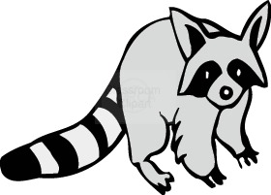
Discussion Questions
Why does Grandpa blame himself for Rubin's death?
How does Billy feel about entering the championship coon hunt?
Notes:
14

Slide 2
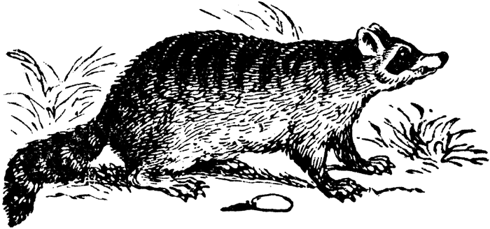
Focus Questions:
Why does Billy think he is the luckiest boy in the world?
What comment does Billy make that indicates he is confident about his chances of winning?
According to Billy, what's the one thing wrong with Little Ann?

Slide 3
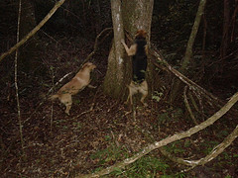
Discussion Questions
Why did Grandpa have an astonished look on his face?
Describe how Billy groomed his dog?
Why was he awarded a small silver cup?
Why did Billy crawl under the buggy?
Notes:
15

Slide 4
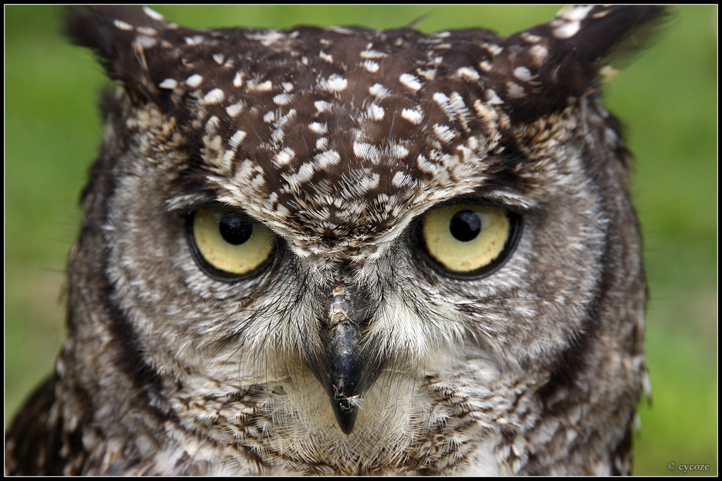
Focus Questions:
Explain the superstition about hearing the owl.
Why was Billy having so much difficulty sleeping?

Slide 5
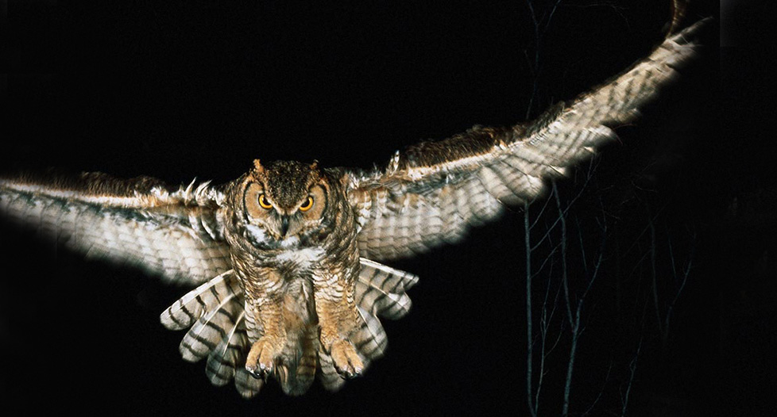
Taking it a little further…
Are you superstitious? Do you know someone who is? Why might people be superstitious? Do you have a favorite number?

Slide 6
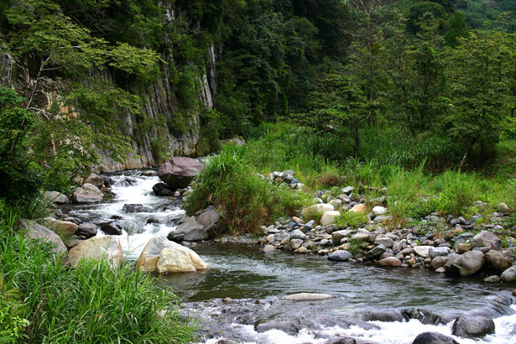
Discussion Questions
Why did the contestants decide to move a few miles downstream?
What is meant by "strike a trail"?
Why did Grandpa try to put his britches on backwards?
Notes:
16

Slide 7
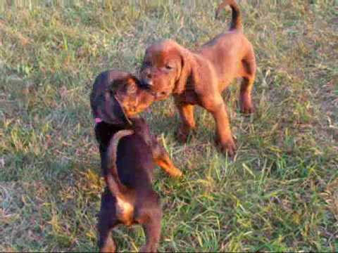
Focus Question:
Explain how the two dogs doctored one another.

Slide 8
Taking it a little further…
Grandpa and Papa obviously respected Billy. How can we tell when parents respect their children? What type of things do you do to let your friends and family know that you respect them?

Slide 9
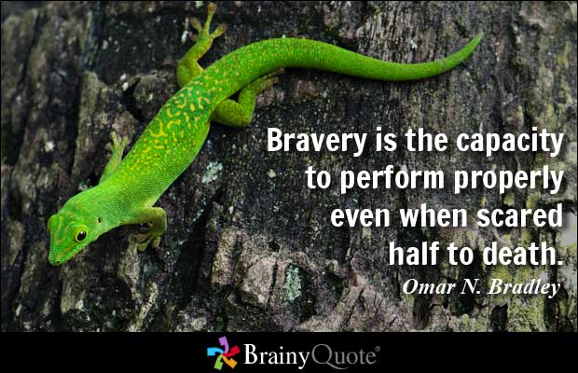
Discussion Questions
How do we know that Billy is a brave and determined boy?
What did the judge say to indicate that he thought it would be wise to give up the hunt?
Notes:
17

Slide 10
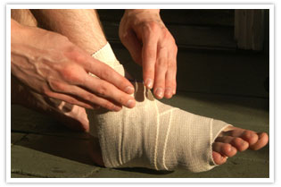
Focus Questions:
Describe what happened to Grandpa.
How did Billy warm Grandpa's injured foot?

Slide 11
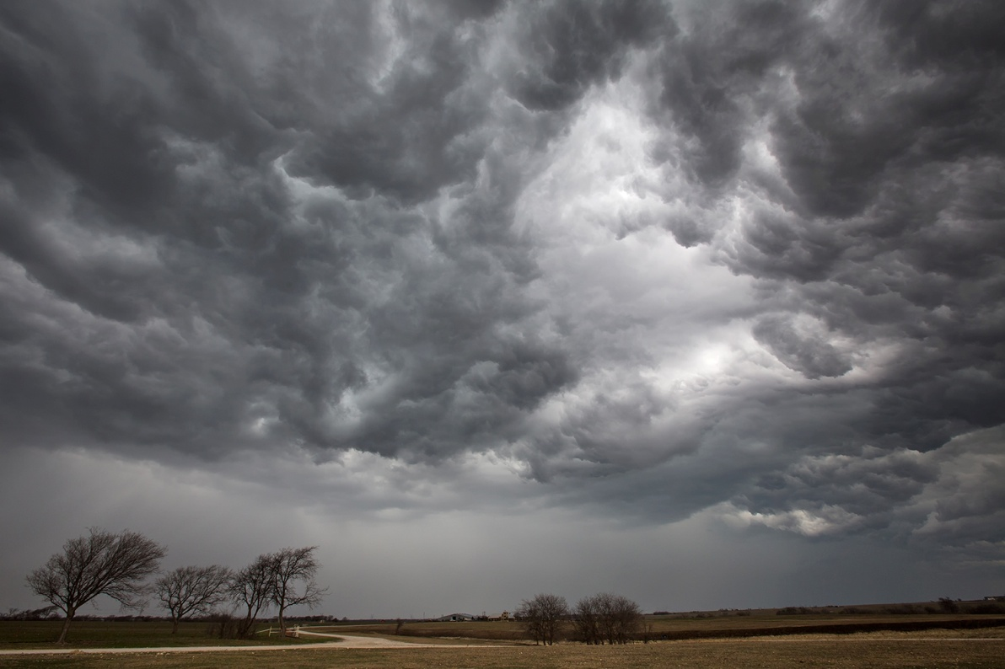
Taking it a little further…
Describe the worst storm that you have ever experienced? Did you ever feel that your life was in danger? Was it Sandy? A snowstorm?

